Slide 1
KOSS TASK(ROUND 2)
GIT CONCEPTS
MADE BY ABHISHEK SAJWAN

Slide 2

Why learn GIT?
The most used technology by developers is GIT

Slide 3

SOME GIT CONCEPTS

Slide 4
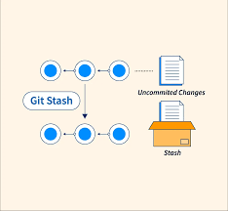
1.GIT STASH
git stash temporarily shelves (or stashes) changes you've made to your working copy so you can work on something else, and then come back and re-apply them later on.
It basically temporarily saves the current changes that we have made since the last commit so that we work/can go to previous commits

Slide 5
2.GIT BISECT
The git bisect command is a powerful tool that quickly checks out a commit halfway between a known good state and a known bad state and then asks you to identify the commit as either good or bad. Then it repeats until you find the exact commit where the code in question was first introduced.

Slide 6
3.GIT REFLOGS
Git keeps track of updates to the tip of branches using a mechanism called reference logs, or "reflogs." Many Git commands accept a parameter for specifying a reference or "ref", which is a pointer to a commit. Common examples include: git checkout.
It gives us the track of our all commits made till now, then we can use it to move between them

Slide 7
4.GIT DIFF
git diff is a multi-use Git command that when executed runs a diff function on Git data sources. These data sources can be commits, branches, files and more. This document will discuss common invocations of git diff and diffing work flow patterns.

Slide 8
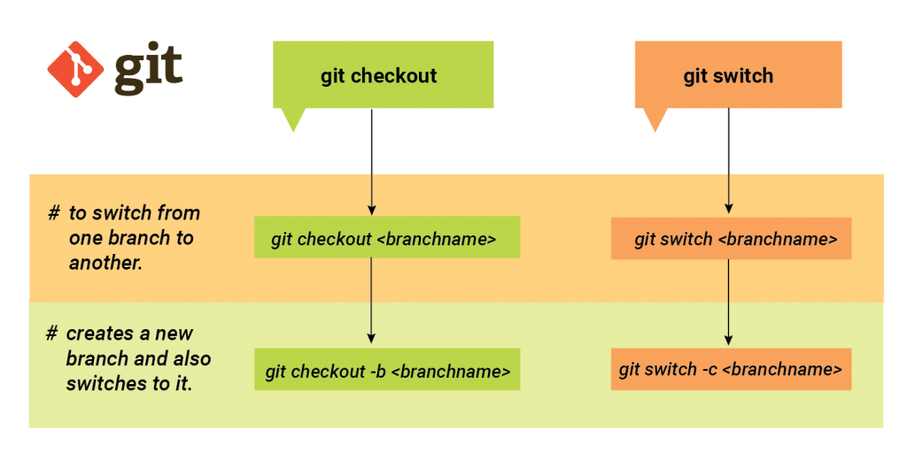
5.GIT SWITCH
The "switch" command allows you to switch your current HEAD branch. It's relatively new (added in Git v2. 23) and provides a simpler alternative to the classic "checkout" command.

Slide 9
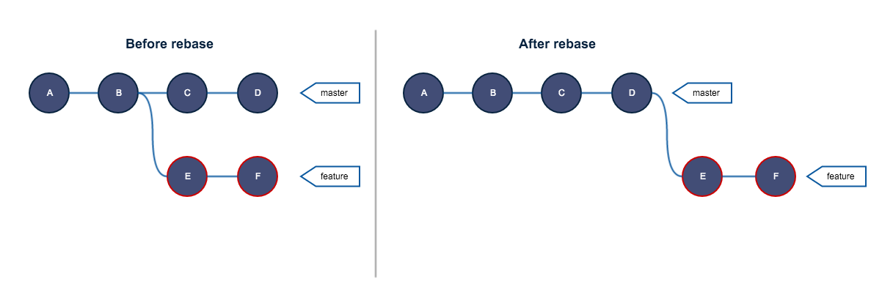
6.GIT REBASE
Rebasing is the process of moving or combining a sequence of commits to a new base commit. Rebasing is most useful and easily visualized in the context of a feature branching workflow.

Slide 10
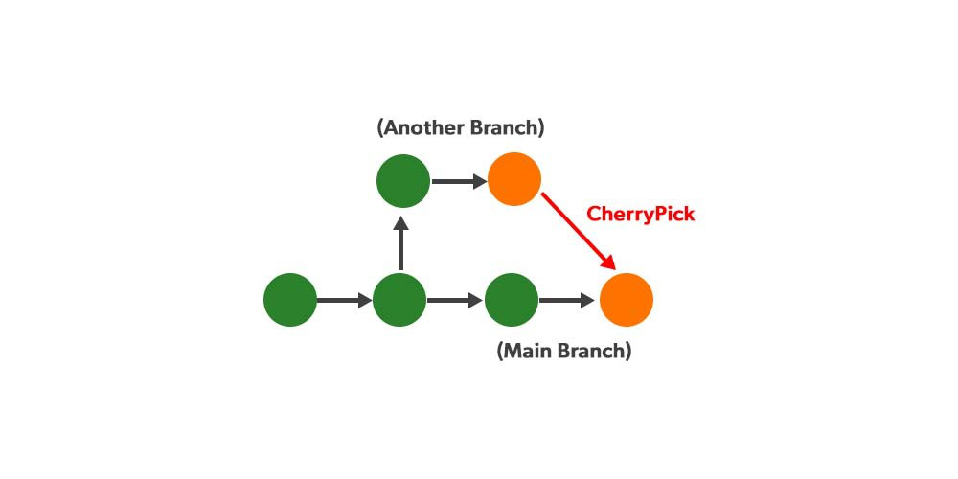
7.GIT CHERRY-PICK
git cherry-pick is a powerful command that enables arbitrary Git commits to be picked by reference and appended to the current working HEAD. Cherry picking is the act of picking a commit from a branch and applying it to another. git cherry-pick can be useful for undoing changes.

Slide 11
THANK YOU

